Slide 1
Department of Information Technology School of Studies in Engineering and Technology B.Tech – VII Semester (Session 2022-2023)
Project Name
Student Support And Progression(CRM)
Name of Project Members:-
Arvind Kumar(19107710)
Samar Mahato(19107757)
Atul Kumar(19107712)
Project Guide:-
Asst. Prof. Deepak Kant Netam

Slide 2
Abstract of project
Student Support And Progression(CRM- Content Resource) is the platform in which all student of our college or other colleges can create a community to collabrate. This is on-campus discussion forum for the student of the campus. The platform Student Support And Progression is a blockchain based platform that is used for students interaction and as well as students can posts their achievement that will helpful to the department to collect the data of the students. The user needs to create an account to posts questions, achievement and answers .

Slide 3
Introduction
Student Support And Progression – It is the decentralized platform for the effective interaction, effective exposer, and a right direction towards communication. This application is to provide our users opportunities to enhance their knowledge by sharing their views (by asking and answering questions) and discussions with other users.
Also, Students can share their achievements like GATE/CAT/GRE/JAM score, achieved medals in competitions, scholarships, etc. that will save in blockchain database and provide the secure and transparent information management. There is no third party allows to misuse the data and its provide the owners data control.

Slide 4
Objective of the project
Using the blockchain to develop a effective platform for interaction, exposure and quality communication between the students regarding questions, answer and their secure data management. It is developed by blockchain based database.

Slide 5
Literature Review
These are some researches work we came across which have some similarities with our projects:
Dinesh Kumar K,Senthil P, and Manoj Kumar D.S, “Educational Certificate Verification System Using Blockchain”, International Journal of Scientific & Technology Research, ISSN2277-8616,Vol.9, No. 3,pp.82-85, 2020
Valeti Deepika, 2D. Lalitha Bhaskari 1M.Tech Student, Department of Information Technology, 2Professor, Department of Computer Science and Systems Engineering, Andhra University College of Engineering (A), Andhra University, Visakhapatnam, AP, India. © 2020 JETIR November 2020, Volume 7, Issue 11 www.jetir.org (ISSN-2349-5162)
Md. Sabab Zulfiker, Nasrin Kabir, Al Amin Biswas, Partha Chakraborty and Md. Mahfujur Rahman, “Predicting Students’ Performance of the Private Universities of Bangladesh using Machine Learning Approaches” International Journal of Advanced Computer Science and Applications(IJACSA), 11(3), 2020.

Slide 6
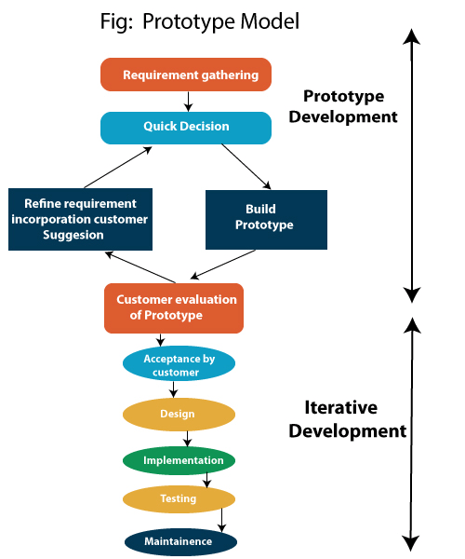
Proposed methodology
The prototyping model is a systems development method in which prototype is build, tested, and then reworked as necessary until an acceptance outcome is achieved from which the complete system or product can be developed. We will follow the following methodology: -
Requirement Analysis
Feasibility Study
Create a prototype
Customer review and approval
Design
Coding
Testing
Installation and Maintenance

Slide 7
Hardware/ Software Requirement
Software
VS code: “^1.73”
RemixId : “^0.28.1”
Metamask (Ethereum wallet)
GitHub: “^2.7.4”
Figma
Frontend Technology
HTML5
CSS(Cascading style sheet)
JavaScript (web3.JS library)
ReactJS: “^17.0.2”
Backend Technology
NodeJS: “^16.14.1”, Web3.0 Module
Solidity: “^0.8.7”
Moralis : “^1.3.1”
Web3uikit:"^0.1.75"
Blockchain Network
Mumbai Testnet(Polygon) Network

Slide 8
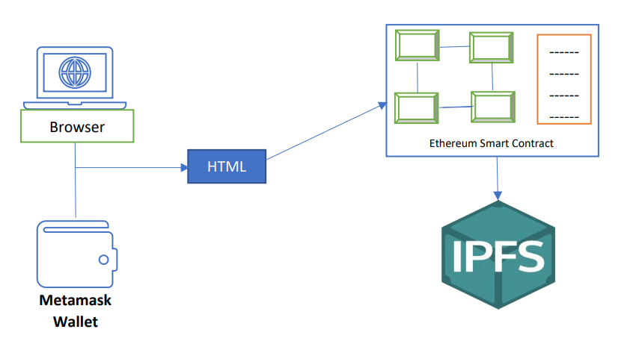
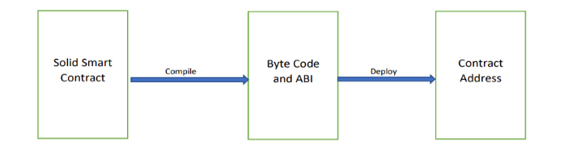
Follow Diagram
Work Follow of Smart Contract
Workflow Diagram to connect IPFS

Slide 9
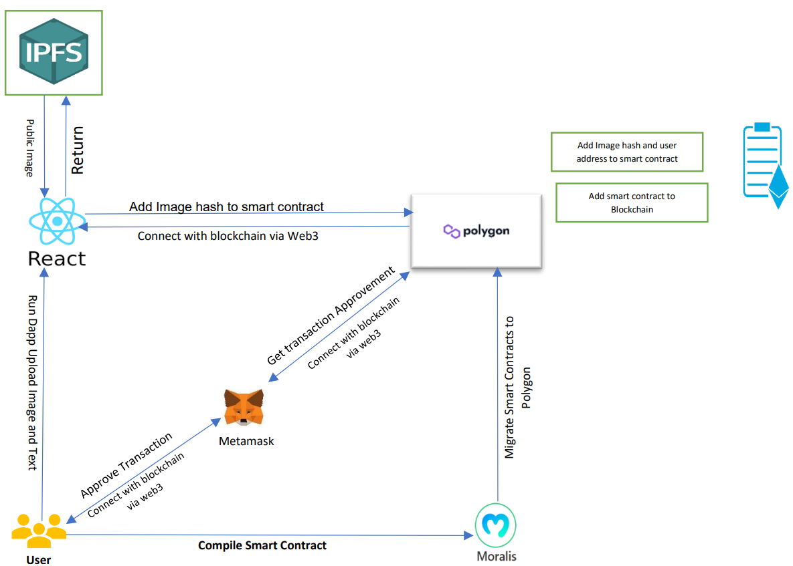
Proposed Work
Workflow Diagram the system

Slide 10
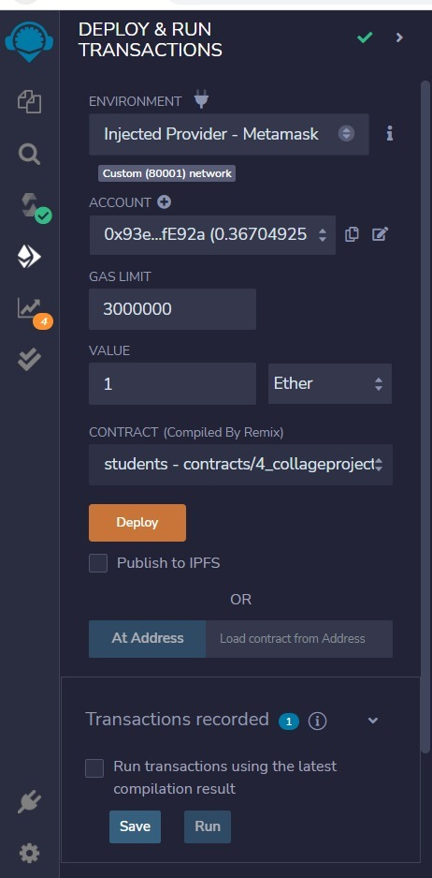
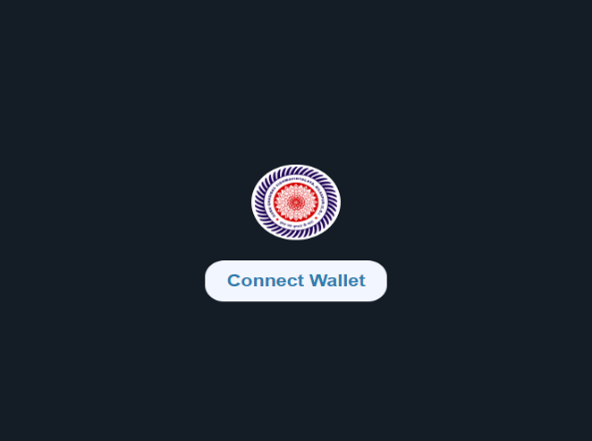
Output
Authenticate Through Metamask
Deployment of smart contract in RemixIDE

Slide 11
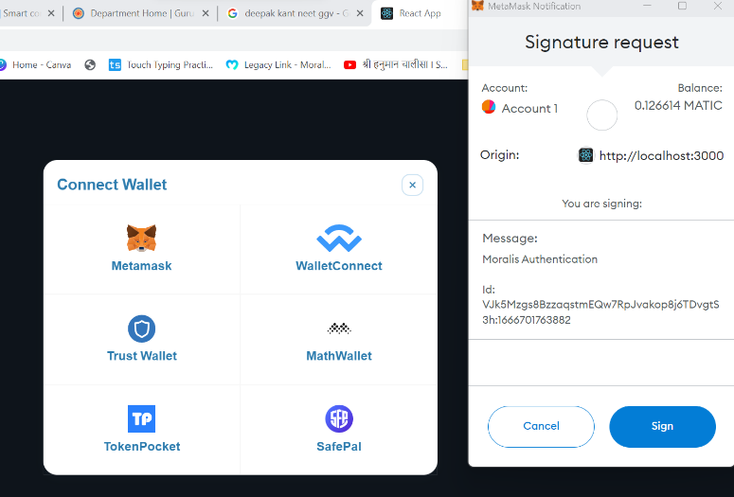
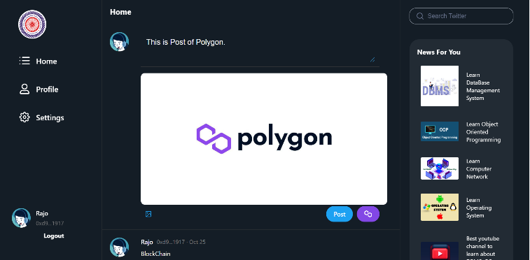
Output
Metamask Notification to Connect Database for Sign In
Upload Image and Text

Slide 12
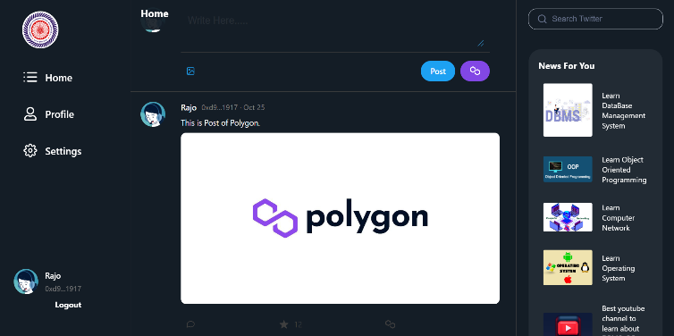
Output
Final Output

Slide 13
Feasibility Study
Validating appropriate objectives for a blockchain based project is a crucial stage to determining its feasibility.
Apart from Ethereum we are used Matic that provide more feasibility to authenticate the user.
Most of the using applications are freely available for the testing purpose that will very feasible to enhance the project with commercial purpose.
The major challenge in blockchain technology doesn’t allow modification of the data once the recorded.

Slide 14
Future work (Scope of work):
For the aspects of the work, there are some functionalities which could be added to the project.
This decentralised technology based on block chains can also be applied to other social media applications.
Direct interact with student-student, student-faculty and faculty-head of the department.
And also add the Certificate Verification System that will help the Universities and Colleges (Shortens the verification time of the college degree 2-3 days to 10 minutes).

Slide 15
Thank You

